Slide 1
C++ Part II
X52.9265-01
Yedidiah Solowiejczyk
Week#7
New York University
School
of
Professional and Continuous Studies
C++ Part II

Slide 2
Synopsis
_x0018_Polymorphism and Virtual Functions
REVIEW OF INHERITANCE
  Redefinition vs. Overloading
VIRTUAL FUNCTION BASICS
  Early vs. Late Binding
  Virtual Functions in C++
  Virtual Property Is Inherited
  When to Use a Virtual Function
  PITFALL Omitting the Definition of a Virtual Member Function
  Abstract Classes and Pure Virtual Functions
  EXAMPLE An Abstract Class
POINTERS AND VIRTUAL FUNCTIONS
  Virtual Functions and Extended Type Compatibility
  The Slicing Problem
  Making Destructors Virtual
  Downcasting and Upcasting
  How C++ Implements Virtual Functions
Financial Engineering Examples of Inheritance
  One Factor Payoff
C++ Part II

Slide 3
Review of Inheritance Basics
Base class
  "General" class from which others derive
Derived class
  New class
  Automatically has base class’s:
    Member variables
    Member functions
  Can then add additional functionality via new member functions and variables
Example:
Derived class exhibits a “is a” relation between classes
class Person{ // Base Class
int age;
char name[32];
};
class Employee: public Person{//derived
float salary;
etc
};
class Student : public Person{//derived
int grade;
int student_id;
};
C++ Part II

Slide 4
Review Of Inheritance
Redefinition of Member Functions
  Recall interface of derived class:
  Contains declarations for new member functions
  Contains declarations for new member data
  Contains declarations for inherited member functions to be redefined
  Inherited member functions NOT declared:
    Automatically inherited unchanged
Implementation of derived class will:
  Define new member functions
  Redefine inherited functions as declared
C++ Part II

Slide 5
Redefining vs. Overloading
Very different!
  Redefining in derived class:
    SAME parameter list
    Essentially "re-writes" same function – diff task
  Overloading in derived class:
    Different parameter list
    Defined "new" function that takes different parameters
    Overloaded functions must have different signatures
    Sequence of types in parameter list
        Including order, number, types
    Signature does NOT include:
  Return type
  const keyword or &
    A function that has same name in derived class as in base class but has different signature is overloaded – not redefined
C++ Part II

Slide 6
Functions Not Inherited
All "normal " functions in base class are
inherited in derived class
Exceptions:
  Constructors
  Destructors
  Copy constructor
    But if not defined, compiler generates "default" one
    Recall need to define one for pointers!
  Assignment operator
    If not defined ➔ compiler provides default
Assignment Operator=( ) and Copy Constructors
  Base member functions can be used in derived class definitions
  Typically MUST be used!
  Similar to how derived class constructor invokes base class constructor
C++ Part II

Slide 7
Name Hiding
class X{
private:
// data members data #1
public:
//constructors, etc
:::::::::::::::
// member functions
int tax( ){return 0;}
int tax( int sum){ return sum*0.0825;} //overloaded function
};
class Y: public X{
private:
// data members data #2
public:
//constructors, etc
:::::::::::::::
int tax(int sum){return sum*0.09;} //redefined overloaded function
}
int main( )
{
X X1; //base class
Y Y1; //derived class
int tax1 = X1.tax(100); // 8.25% tax
tax1 = X1.tax( ); // 0% taxt
int tax2 = Y1.tax(1000); //10% tax
int tax3 = Y1.X::tax(1000); // trying to underpay taxes
// tax3 = Y1.tax( ); // Error ! - Name Hiding
}
Anytime you redefine an overloaded function name from base, all other versions are hidden
C++ Part II

Slide 8
Base Class Attributes
Base class
  "General" class from which others derive
class Person{ // Base Class
protected:
int age;
char name[32];
public:
//constructors & destructors
Person( ):age(0); //default constructor
Person(int Age, char * Name): age(Age){strcpy(name, Name);|
~Person( ){ }
Person( const Person &); //copy constructor
//mutator and accessor
void setAge(int Age){age = Age;}
void setName(char *Name){strcpy(name, Name;}
int getAge( ) const {return age;}
char *getName( ) const {return name;}
// other member functions
void Print( ){printf(“Base Class – name = %s age = %d\n”, name, age);}
};
C++ Part II

Slide 9
Early vs. Late Binding
Procedural Languages ~ C Programming
- Compiled code creates code that has Static (early) Binding
Object Oriented Languages ~ C++ Programming
- Compiled Code produces two binding methods
    Early & Late (Dynamic) Binding
Early Binding ~ C Programming
- Refers to requirement that all direct functions be known at compile time (function call is associated with machine address)
Example:
int age( ){ return age;}
void print_age( ){printf(“Age = %d\n”, age);}
int main( )
{
int age = 15;
age = get_age( );
print_age)( );
}
Compiler binds two functions calls directly into its object code.
Beyond a a shadow of a doubt we know the order the functions are executed
C++ Part II

Slide 10
Late Binding
Late Binding ~ C Programming
- run-time resolution / dynamic loading
- 'Late' refers to the fact that the binding decisions (which binary to load, which function to call) is deferred as long as possible.
- Often until just before the function is called, rather than having the binding decisions made at compile time (early).
- In C, one way to get late binding is to use function pointers.
  Instead of calling function directly, one can dereference the function pointers to execute correct function thus the compiler does not know exactly what function will be called.
C++ Part II

Slide 11
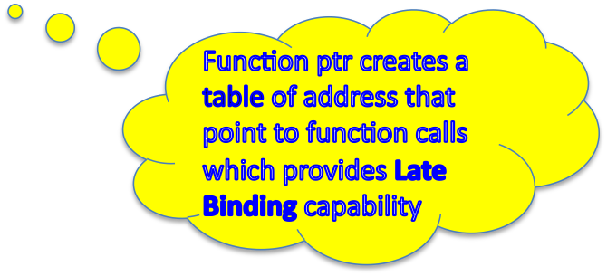
Late Binding
Late Binding ~ C Programming
Example:
int Add(int nX, int nY){return (nX+nY);} //Series of arithmetic functions
int Subt(int nX, int nY){return (nX-nY);}
int Mult(int nX, int nY){return (nX*nY);}
int Div(int nX, int nY){return (nX/nY);}
int (*menu[ ])(int, int) = {Add, Subt, Mult, Div}; //array of function ptrs
int main( )
{
int nX, int nY;
int flag; //Arithmetic choice flag
int ans;
nX = nY =10;
do
{
cout << “Enter Arithmetic Choice(0-3)” >> endl;
cint >> flag;
ans = menu[flag](nX, nY);
cout << “flag(“ << flag “) – ans = “ << ans << endl;
} while (flag < 4);
}
C++ Part II

Slide 12
Late Binding
Late Binding ~ C++ Programming
Example:
int (*menu[ ])(int, int) = {Add, Subt, Mult, Div}; //array of function ptrs
{
int nX, int nY;
::::::::::::::::::::::::::::::::
do
{
::::::::::::::::::::::::::::::::
ans = menu[flag](nX, nY);
::::::::::::::::::::::::::::::::
} while (flag < 4);
}
Function Pointer Table Address Memory
menu[0] ➔ 0X1000 0X1000 Add Function
menu[1] ➔ 0X2000 0X2000 Subt Function
Menu[2] ➔ 0X3000 0X3000 Mult Function
Menu[3] ➔ 0X3000 0X3000 Div Function
In C++ late binding can be achieved by using similar table function pointers to perform late binding (vTable)
C++ Part II

Slide 13
Review of Polymorphism
Polymorphism is composed of
  prefix poly- meaning many
  the root word, -morph- meaning shape, and
  -ism, an action suffix.
Polymorphism"… the ability to associate multiple meanings with one function name."
Function name overloading is polymorphism in this more general sense (fundamental OOP mechanism)
Biological Polymorphism
  ❖ The occurrence of different forms, stages, or types in individual organisms or in organisms of the same species, independent of sexual variations.
  The most obvious example of polymorphism are:
    the separation of most higher organisms into male and female sexes & the different blood types in humans.
C++ Part II

Slide 14
OOP Polymorphism
Polymorphism
  Associating many meanings to one function.
  Capability of deciding at run time which of the overloaded member functions to call
  It is a fundamental principle of OOP
  Polymorphism (implemented in with virtual functions) is the third essential feature of an object-oriented programming language, after data abstraction and inheritance.
  - Polymorphism means that some code, operations or objects behave differently in different contexts.
  - Polymorphism allows one to treat derived objects as if they were base object
  Polymorphism refers to the capability to exhibit late binding
  Polymorphism allows improved code organization and readability as well as the creation of extensible programs that can be “grown”
C++ Part II

Slide 15
Polymorphism
Encapsulation creates new data types by combining characteristics and behaviors.
Access control separates the interface from the implementation by making the details private.
Virtual functions deal with decoupling in terms of types.
  Inheritance allows the treatment of an object as its own type or its base type.
  This ability is critical because it allows many types (derived from the same base type) to be treated as if they were one type, and a single piece of code to work on all those different types equally.
  The virtual function allows one type to express its distinction from another as long as they’re both derived from the same base type.
  This distinction is expressed through differences in behavior of the functions that you can call through the base class.
C++ Part II

Slide 16
Pointers in Derived Classes
A derived class object is already of base class type
The address of either a base class object or a derived class object may be assigned to a variable of type pointer to base class.
Suppose a member function is declared in the base class and a function with the same signature is declared in the derived class.
  The base class and derived class functions have different implementations, appropriate to the respective class.
If the member function is called through a pointer of type base, the function that is called is always the base class function.
class C: public B{
public:
void foo( ); //redefines and hides
};
B *b1, *b2;
b1->foo; b2->foo; //both call B::foo( )
class B{
public:
void foo( );
};
C++ Part II

Slide 17
Need for Virtual Functions
Recall that the instantiation of a derived class is also the instantiation of a base class
Pointers to base class can be used to point to derived class object
Pointers to derived class cannot be used to point to base class objects
Derived objects accessed via base class pointers cannot resolve overridden functions at runtime
  Alternate mechanism needed – virtual functions
Declaring a function to be virtual in the base class requires that the the function be overridden in the derived class
  Virtual functions implement late binding
    only required to declare a function virtual in the base class
C++ Part II

Slide 18
Need for Virtual Functions
Virtual member functions should be defined prior to compiling – error messages
Example – No Virtual function
class Student{
int numCredits;
public:
//constructors, destructors, assignment, etc
float calcTuition( ){ return (numCredits*300);}
};
class GradStudent:public Student
{
public:
float calcTuition( ){ return (numCredits*400);}
};
int main( ){
float cost1, cost2;
Student X(12);
GradStudent Y(9);
Student *ptr1 = &X, *ptr2 = &Y;
cost1= X.calcTution(12); //OK - $3600
cost2 = Y.calcTuition(12); // OK - $4800
cost1 = ptr1->calcTution(12); // OK - $3600
cost2 = ptr2->calcTution(9);; // NOK - $3600
}
Example
class Student{
int numCredits;
public:
//constructors, destructors, assignment, etc
virtual float calcTuition( ){ return (numCredits*300);}
};
class GradStudent : public Student
{
public:
virtual float calcTuition( ){ return (numCredits*400);}
};
int main( ){
float cost1, cost2;
Student X(12);
GradStudent Y(9);
Student *ptr1 = &X, *ptr2 = &Y;
cost1= X.calcTution(12); //OK - $3600
cost2 = Y.calcTuition(12); // OK - $4800
cost1 = ptr1->calcTution(12); // OK - $3600
cost2 = ptr2->calcTution(9);; // OK - $4800
}
If the function had not been declared virtual, then the base class function would have been called all the times.
C++ Part II

Slide 19
Need for Virtual Functions - cont
Base class virtual functions can be overridden in the derived classes
Base class member functions can be redefined in the derived classes!
The overridden & redefined functions in the derived class extend the capability of the function in the derived class
  Virtuality Tells compiler: "Don’t know how function is implemented - Wait until used in program then get implementation from object instance”
  Virtual functions overridden in derived classes are also virtual
  Derived member functions use overridden virtual functions
C++ Part II

Slide 20
Need for Virtual Functions§
//: C15:Instrument3.cpp §
// Late binding with the virtual keyword
#include <iostream>
using namespace std;
enum note { middleC, Csharp, Cflat }; // etc
class Instrument
{
public:
virtual void play(note) const
{ cout << "Instrument::play" << endl; }
};
§ - see Eckel (chapter 15) & Instrument.cpp
// Wind objects are Instruments
// because they have the same interface:
class Wind : public Instrument {
public: // Override interface function:
virtual void play(note) const
{ cout << "Wind::play" << endl; }
};
void tune(Instrument &i)
{ i.play(middleC);}
int main()
{
Wind flute; //derived object
tune(flute); // Upcasting} ///:~
}
Virtual member functions should be defined prior to compiling – error messages
If the function had not been declared virtual, then the base class function would have been called all the times.
C++ Part II

Slide 21
Overloading & overriding
Keep in Mind:
Redefining an overloaded function in the base class hides all of the other base-class versions of that function.
The compiler will not allow you to change the return type of an overridden function (it will allow it if f( ) is not virtual).
  This is an important restriction because the compiler must guarantee that you can polymorphically call the function through the base class, and if the base class is expecting an int to be returned from f( ), then the derived-class version of f( ) must keep that contract or else things will break.
C++ Part II

Slide 22
Pitfalls
Omitting the Definition of a Virtual Member Function.
If you try to compile classes with virtual member functions but do not implement each member, you may run into some obtuse error messages, even if you do not call the undefined member functions.
This caution does not apply to pure virtual functions.
C++ Part II

Slide 23
Extensibility
Extensibility
With play( ) defined as virtual in the base class, you can add as many new types as you want without changing the tune( ) function.
In a well-designed OOP program, most or all of your functions will follow the model of tune( ) and communicate only with the base-class interface.
Such a program is extensible because you can add new functionality by inheriting new data types from the common base class.
The functions that manipulate the base-class interface will not need to be changed at all to accommodate the new classes.
Example
class Instrument {
public:
virtual void play(note) const {cout << "Instrument::play" << endl;}
virtual char* what() const {return "Instrument"; }// this modifies the object:
virtual void adjust(int) {cout << “Adjust Instrument” << endl;} };
class XXX : public Instrument {
public:
void play(note) const { cout << ”XXX::play" << endl; }
char* what() const { return ”XXX"; }
void adjust(int) {cout << “Adjust XXX” << endl;} };
C++ Part II

Slide 24
Virtual Functions & Constructors
When an object containing virtual functions is created, its VPTR must be initialized to point to the proper VTABLE.
This must be done before there’s any possibility of calling a virtual function.
Because the constructor has the job of bringing an object into existence, it is also the constructor’s job to set up the VPTR.
The compiler secretly inserts code into the beginning of the constructor that initializes the VPTR
If you don’t explicitly create a constructor for a class, the compiler will synthesize one for you.
If the class has virtual functions, the synthesized constructor will include the proper VPTR initialization code.
Not only must the constructor initialize the VPTR, it must also check the value of this (in case the operator new returns zero) and call base-class constructors.
Inline constructor code might overcome savings from calling function calls
C++ Part II

Slide 25
Behavior of virtual functions inside constructors
What happens if you’re inside a constructor and you call a virtual function?
Inside an ordinary member the virtual call is resolved at runtime because the object cannot know whether it belongs to the class the member function is in, or some class derived from it.
For consistency, you might think this is what should happen inside constructors.
  If you call a virtual function inside a constructor, only the local version of the function is used. That is, the virtual mechanism doesn’t work within the constructor.
  When a constructor is called, one of the first things it does is initialize its VPTR. However, it can only know that it is of the “current” type – the type the constructor was written for.
  The constructor code is completely ignorant of whether or not the object is in the base of another class.
  The constructor has the special job of putting an object together piece-by-piece, first by calling the base constructor, then the more derived constructors in order of inheritance (it must also call member-object constructors along the way).
C++ Part II

Slide 26
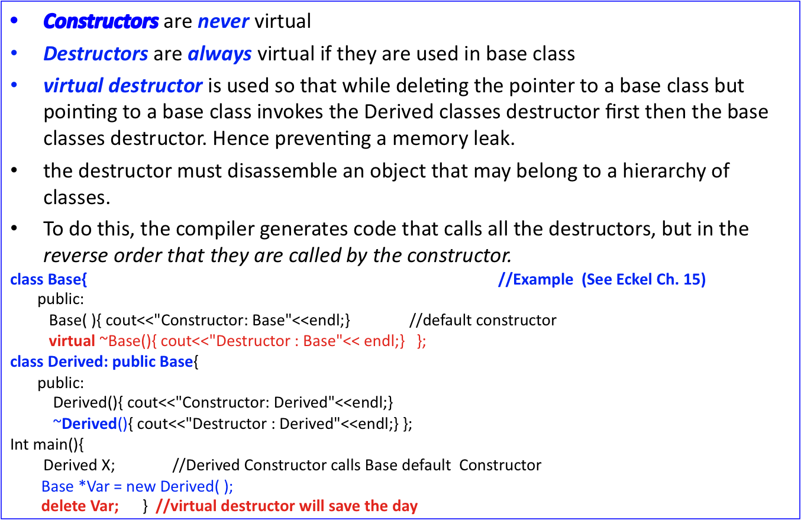
Virtual Constructors & Destructors
When X goes out of scope it first invokes Derived destructor and then Base destructor
C++ Part II

Slide 27
Abstract Classes & Pure Virtual Functions
Abstract data types (ADT) such as shape represents a concept rather than an object (e.g. circle).
ADT is always the base class to other classes and it is not valid to make an instance of an ADT
C++ supports the creation of abstract data types with pure virtual functions by initializing as follows:
  virtual void draw( ) = 0;
Putting a pure virtual function in your class signals two things to clients of the class:
  No need to give definition of pure virtual function§
  Don’t make an object of this class: derive from B
  Any class that derives from an ADT inherits the pure virtual function as pure
  Make sure to override the pure virtual functions in the derived class otherwise the derived class will also be an ADT
Typically pure virtual functions in and ADT are never implemented so there is no need to provide implementation and it works mainly as a definition of interface to objects derived from it
Deriving from ADT can produce “real” object if you override all virtual functions
§ - except for pure virtual destructors
Compiler reserves a slot for a function in the VTABLE, but doesn’t put an address in that particular slot.
C++ Part II

Slide 28
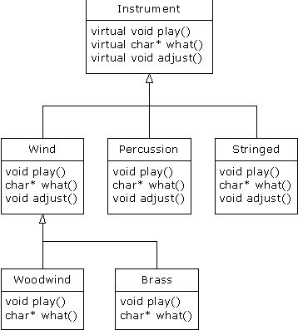
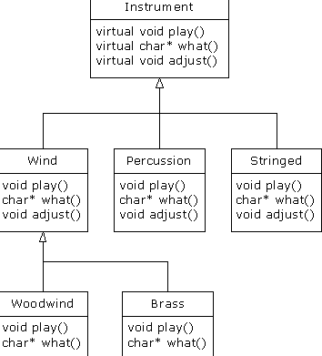
Abstract Classes & Pure Virtual Functions
Often in a design, you want the base class to present only an interface for its derived classes.
That is, you don’t want anyone to actually create an object of the base class, only to upcast to it so that its interface can be used.
This is accomplished by making that class abstract, i.e. give it at least one pure virtual function.
When an abstract class is inherited, all pure virtual functions must be implemented, or the inherited class becomes abstract as well.
Creating a pure virtual function allows you to put a member function in an interface without being forced to provide a possibly meaningless body of code for that member function.
A pure virtual function forces inherited classes to provide a definition for it.
the intent of Instrument is to create a common interface for all of the classes derived from it
C++ Part II

Slide 29
Pure virtual destructors
You must provide a function body for the pure virtual destructor.
Recall that constructors and destructors are special, especially if you remember that all destructors in a class hierarchy are always called.
The only difference you’ll see between the pure and non-pure virtual destructor is that the pure virtual destructor does cause the base class to be abstract, so you cannot create an object of the base class.
when you inherit a class from one that contains a pure virtual destructor. Unlike every other pure virtual function, you are not required to provide a definition of a pure virtual destructor in the derived class.
When you have a class that only has a single pure virtual function, namely; the destructor. In this case, the only effect of the purity of the destructor is to prevent the instantiation of the base class. If there were any other pure virtual functions, they would prevent the instantiation of the base class, but if there are no others, then the pure virtual destructor will do it.
the base class destructor is being quietly overridden, and thus the definition is being provided by the compiler and Derived is not actually abstract
class Pet {
public:
virtual ~Pet() = 0;
};
Pet::~Pet() { cout << "~Pet()" << endl;}
class Dog : public Pet {
public:
~Dog() { cout << "~Dog()" << endl; } };
int main() {
Pet* p = new Dog;
delete p; // Virtual destructor call
} //*** See PurePet.cpp and PureAbstr.cpp***
/**Results **/
default Pet Constructor
default Dog Constructor
~Dog()
~Pet()
C++ Part II

Slide 30
Casting
Consider:
Pet vpet;
Dog vdog;
…
vdog = static_cast<Dog>(vpet); //ILLEGAL!
Can’t cast a pet to be a dog, but:
vpet = vdog; // Legal!
vpet = static_cast<Pet>(vdog); //Also legal!
Upcasting is OK
  From descendant type to ancestor type
C++ Part II

Slide 31
Downcasting
Upcasting – casting from child to parent is safe
Downcasting is dangerous!
  Casting from ancestor type to descended type
  Assumes information is "added"
  Can be done with dynamic_cast:
  Pet *ppet;
  ppet = new Dog;
  Dog *pdog = dynamic_cast<Dog*>(ppet);
    Legal, but dangerous!
Downcasting rarely done due to pitfalls
  Must track all information to be added
  All member functions must be virtual
  C++ provides an explicit cast ( dynamic_cast ) - type-safe downcast operation.
  When you use dynamic_cast to try to cast down to a particular type, the return value will be a pointer to the desired type only if the cast is proper and successful, otherwise it will return zero to indicate that this was not the correct type.
Pet vpet;
Dog vdog;
vdog = //illegal static_cast<Dog>(vpet);
C++ Part II

Slide 32
Downcasting
Downcasting Example
#include <iostream>
using namespace std;
class Pet { public: virtual ~Pet(){} };
class Dog : public Pet {};
class Cat : public Pet {};
int main() {
Pet* b = new Cat;
Dog* d1 = dynamic_cast<Dog*>(b); // Upcast // Try to cast it to Dog*:
Cat* d2 = dynamic_cast<Cat*>(b); // Try to cast it to Cat*:
cout << "d1 = " << (long)d1 << endl;
cout << "d2 = " << (long)d2 << endl;
}
When you use dynamic_cast, you must be working with a true polymorphic hierarchy – one with virtual functions – because dynamic_cast uses information stored in the VTABLE to determine the actual type.
when you run the program incorrect downcast produces a zero result.
C++ Part II

Slide 33
Extended Type Compatibility
Derived objects can be assigned to objects of type Base
But NOT the other way!
Example
class Pet{
public:
string name;
virtual void print() const;
};
class Dog : public Pet{
public:
string breed;
virtual void print() const;
};
Dog vdog;
Pet vpet;
Anything that "is a" dog "is a" pet:
vdog.name = "Tiny";
vdog.breed = "Great Dane";
vpet = vdog;
These are allowable
Can assign values to parent-types, but not reverse
A pet "is not a" dog (not
necessarily)
C++ Part II

Slide 34
Slicing Problem
Dog vdog;
Pet vpet;
Notice value assigned to vpet "loses" it’s breed field!
  cout << vpet.breed; //Produces ERROR msg!
  Called “slicing problem”
Might seem appropriate
  Dog was moved to Pet variable, so it should be treated like a Pet
    And therefore not have "dog" properties
In C++, slicing problem is nuisance
  It still "is a" Great Dane named Tiny
  We’d like to refer to it’s breed even if it’s been treated as a Pet
Can do so with pointers to dynamic variables
Assigning a derived class object to a base class object slices off data
C++ Part II

Slide 35
Slicing Problem
Pet *ppet; //pointer to base class
Dog *pdog; //pointer to derived class
pdog = new Dog;
pdog->name = "Tiny";
pdog->breed = "Great Dane";
ppet = pdog; //upcasting
Cannot access breed field of object pointed to by ppet:
cout << ppet->breed; //ILLEGAL!
Must use virtual member function:
ppet->print();
  Calls print member function in Dog class!
    Because it’s virtual
  C++ "waits" to see what object pointer ppet is actually pointing to before "binding" call
  Look at Posted Application: Slicing.cpp
C++ Part II

Slide 36
How does Polymorphism Work
Whenever a C++ class has one or more virtual functions declared or you derive from a class that contains virtual functions, a v-table is constructed for the class.
The v-table contains the addresses of all the functions that are declared virtual in this class or in the base class.
If you don’t override a function that was declared virtual in the base class, the compiler uses the address of the base-class version in the derived class.
There is only one VPTR for each object when using simple inheritance.
The VPTR must be initialized to point to the starting address of the appropriate VTABLE.
Once the VPTR is initialized to the proper VTABLE, the object in effect “knows” what type it is.
C++ Part II

Slide 37
How does Polymorphism Work
When you call a virtual function through a base class address (the situation when the compiler doesn’t have all the information necessary to perform early binding), the compiler generates different code to perform the function call.
Here’s what a call to adjust( ) for a Brass object looks like, if made through an Instrument pointer.
The compiler begins with the Instrument pointer, which points to the starting address of the object.
All Instrument objects or objects derived from Instrument have their VPTR in the same place (often at the beginning of the object), so the compiler can pick the VPTR out of the object.
The VPTR points to the starting address of the VTABLE.
All the VTABLE function addresses are laid out in the same order, regardless of the specific type of the object.
play( ) is first, what( ) is second, and adjust( ) is third.
The compiler knows that regardless of the specific object type, the adjust( ) function is at the location VPTR+2. Thus it generates code that says “Call the function at VPTR+2.”
Because the fetching of the VPTR and the determination of the actual function address occur at runtime, you get the desired late binding.
You send a message to the object, and the object figures out what to do with it.
C++ Part II

Slide 38
How does Polymorphism Work
Example
enum note { middleC, Csharp, Cflat };
class Instrument {
public:
virtual void play(note) const {cout << "Instrument::play" << endl; }
virtual char* what() const { return "Instrument"; } Assume this will modify the object:
virtual void adjust(int) {} };
class Wind : public Instrument {
public:
void play(note) const {cout << "Wind::play" << endl; }
char* what() const { return "Wind"; }
void adjust(int) {} };
class Percussion : public Instrument {
public:
void play(note) const { cout << "Percussion::play" << endl; }
char* what() const { return "Percussion"; }
void tune(Instrument& i) { // ... i.play(middleC);} }
class Stringed : public Instrument {
public:
void play(note) const { cout << "Stringed::play" << endl; } char* what() const { return "Stringed"; } void adjust(int) {}};
class Brass : public Wind {
public:
void play(note) const { cout << "Brass::play" << endl; } char* what() const { return "Brass"; } };
void tune(Instrument& i) { i.play(middleC);}
//Array of pointers to Instruments
Instrument* A[] = { new Wind, new Percussion,
new Stringed, new Brass,};
int main() {
Wind flute;
Percussion drum;
Stringed violin;
Brass flugelhorn;
Woodwind recorder;
tune(flute);
tune(drum);
tune(violin);
tune(flugelhorn);
tune(recorder);
}
C++ Part II

Slide 39
How does Polymorphism Work
Installing the vpointer
Because the VPTR determines the virtual function behavior of the object, you can see how it’s critical that the VPTR always be pointing to the proper VTABLE.
You don’t ever want to be able to make a call to a virtual function before the VPTR is properly initialized. Of course, the place where initialization can be guaranteed is in the constructor, but none of the Instrument examples has a constructor.
- In the Instrument examples, the compiler creates a default constructor that does nothing except initialize the VPTR.
- This constructor, of course, is automatically called for all Instrument objects before you can do anything with them, so you know that it’s always safe to call virtual functions.
C++ Part II

Slide 40
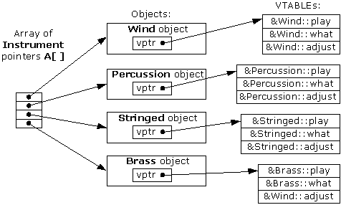
How does Polymorphism Work§
^{§ - see Eckel} Thinking in C++, 2nd ed. Volume 1
C++ Part II

Slide 41

How does Polymorphism Work
When you call a virtual function through a base class address the compiler begins with the Instrument pointer, which points to the starting address of the object.
All Instrument objects or objects derived from Instrument have their VPTR in the same place (often at the beginning of the object), so the compiler can pick the VPTR out of the object. The VPTR points to the starting address of the VTABLE.
All the VTABLE function addresses are laid out in the same order, regardless of the specific type of the object; 1)play( ) ,2) what( ), and 3)adjust( ).
The compiler knows that regardless of the specific object type, the adjust( ) function is at the location VPTR+2.
Because the fetching of the VPTR and the determination of the actual function address occur at runtime, you get the desired late binding.
C++ Part II

Slide 42
How does Polymorphism Work
virtual functions tells the compiler it should not perform early binding.
Instead, it should automatically install all the mechanisms necessary to perform late binding.
This means that if you call play( ) for a Brass object through an address for the base-class Instrument
To accomplish this, the typical compiler creates a single table (called the VTABLE) for each class that contains virtual functions.
The compiler places the addresses of the virtual functions for that particular class in the VTABLE.
In each class with virtual functions, it secretly places a pointer, called the vpointer (abbreviated as VPTR), which points to the VTABLE for that object.
When you make a virtual function call through a base-class pointer (that is, when you make a polymorphic call), the compiler quietly inserts code to fetch the VPTR and look up the function address in the VTABLE, thus calling the correct function and causing late binding to take place.
The VPTR is inserted at the beginning of the object, so the contents of this correspond to the VPTR.
C++ Part II

Slide 43
Financial Engineering Abstract/Concrete Classes§
One-Factor Option Payoff
§ - See Chapter 8 of “Intro to C++ for Financial Engineers” – D. Duffy
Payoff
(Abstract)
Call Payoff
Put Payoff
BullSpread Payoff
etc
Payoff
C++ Part II

Slide 44
One-Factor Option Payoff Class Outline
class Payoff {
public:
//constructors & destructor
virtual ~Payoff( );
// overloaded operator=( )
// pure virtual payoff function
virtual double payoff(double SpotPrice) const = 0;
};
class CallPayoff:public Payoff {
private:
double K; //strike price
public:
//constructors & destructor
virtual ~CallPayoff( );
// overloaded operator=( )
//Mutators & Selectors
double Strike() const;
void Strike(double NewStrike);
};
C++ Part II

Slide 45
One-Factor Option Payoff Class Outline
class Payoff {
::::::::::::::::::::::::::::::::
virtual double payoff(double SpotPrice) const = 0;
};
class BullSpreadPayoff: public Payoff{
private:
double K1; // Strike price 1
double K2; // Strike price 2
double buyValue; // cost to buy
double sellValue; // sell value
public:
// Constructors and destructor
virtual ~BullSpreadPayoff(); // Destructor
// Acccessor & Mutator & Assignment
void Strike1(double NewStrike1); // Set strike price
void Strike2(double NewStrike2); // Set strike price
BullSpreadPayoff& operator = (const BullSpreadPayoff& source); // Assignment operator
// Implment the pure virtual payoff function from base class
double payoff(double S) const; // For a given spot price
double profit(double S) const; // Profit
};
C++ Part II

Slide 46
One-Factor Option Payoff Class Outline
#include "BullSpreadPayoff.hpp”
// Constructors and destructor
BullSpreadPayoff::BullSpreadPayoff(): Payoff()
{ // Default constructor
K1 = K2 = 100.0; // Prototype value
buyValue = 3.0;
sellValue = 1.0;
} BullSpreadPayoff::BullSpreadPayoff(double strike1, double strike2, double BuyVal, double SellVal): Payoff()
{ // Normal constructor with coordinates
K1 = strike1;
K2 = strike2;
buyValue = BuyVal;
sellValue = SellVal;
} BullSpreadPayoff::BullSpreadPayoff(const BullSpreadPayoff& source): Payoff(source){ // Copy Cons
K1 = source.K1;
K2 = source.K2;
buyValue = source.buyValue;
sellValue = source.sellValue;
}
BullSpreadPayoff:: ~BullSpreadPayoff(){ // Destructor}
double BullSpreadPayoff::Strike1() const{// Selectors return K1; // Return K1
}
double BullSpreadPayoff::Strike2() const{
return K2; // Return K2
} // Modifiers
void BullSpreadPayoff::Strike1(double NewStrike1){
K1 = NewStrike1; // Set K1
}
void BullSpreadPayoff::Strike2(double NewStrike2){
K2 = NewStrike2; // Set K2
}
BullSpreadPayoff& BullSpreadPayoff::operator = (const BullSpreadPayoff &source){ // Assignment operator
if (this==&source) return *this;
// Call base class assignment
Payoff::operator = (source);
// Copy state
K1 = source.K1;
K2 = source.K2;
buyValue = source.buyValue;
sellValue = source.sellValue;
return *this;}
double BullSpreadPayoff::payoff(double S) const{
if (S >= K2) // Based on Hull's book
return K2 - K1;
if (S <= K1)
return 0.0;
// In the interval [K1, K2]
return S – K1;}
double BullSpreadPayoff::profit(double S) const{ // Profit
return payoff(S) - (buyValue - sellValue); }
C++ Part II

Slide 47
One-Factor Option Payoff Class Outline
#include "CallPayoff.hpp"
#include "BullSpreadPayoff.hpp”
int main()
{
CallPayoff call(20.0);
cout << "Give a stock price (plain Call): ”;
double S;
cin >> S;
cout << "Call Payoff is: " << call.payoff(S) << endl;
double K1 = 30.0; // Strike price of bought call
double K2 = 35.0; // Strike price of sell call
double costBuy = 3.0; // Cost to buy a call
double sellPrice = 1.0; // Sell price for call
// Hull example
BullSpreadPayoff bs(K1, K2, costBuy, sellPrice);
cout << "Give a stock price (BullSpread): ”;
cin >> S;
cout << "Bull Spread Payoff is: " << bs.payoff(S) << endl;
cout << "Bull Spread Profit is: " << bs.profit(S) << endl;
return 0;
}
C++ Part II

Slide 48
Summary
Polymorphism – implemented in C++ with virtual functions – means “different forms.”
In object-oriented programming, you have the same face (the common interface in the base class) and different forms using that face: the different versions of the virtual functions.
You’ve seen in this chapter that it’s impossible to understand, or even create, an example of polymorphism without using data abstraction and inheritance. Polymorphism is a feature that cannot be viewed in isolation (like const or a switch statement, for example), but instead works only in concert, as part of a “big picture” of class relationships.
To use polymorphism – and thus, object-oriented techniques – effectively in your programs you must expand your view of programming to include not just members and messages of an individual class, but also the commonality among classes and their relationships with each other. This requires significant effort but it’s a worthy struggle, because the results are faster program development, better code organization, extensible programs, and easier code maintenance.
Polymorphism completes the object-oriented features of the language, but there are two more major features in
C++ Part II

